Slide 1
Air Transport System (ATS)
Team 4
Members [modules]

Slide 2
Project Abstract
ATS system is an automated system …..

Slide 3
Project Goals
Prove the application of concepts learnt and practice by applying to a project as a team.
Understand requirements, visualize them using UML diagrams, develop the requirements and verify them by testing.
Use distributed version control system for developing the project as a team.
Apply various libraries, frameworks and tools.
Create a simple working prototype, and follow an iterative fashion to make the prototype better and apply best practices.
Implement a loosely-coupled, highly reusable code and integrate all the modules developed from day 1 of the training.
Develop the project in parallel with the sessions.
Explore the docs and observe different patterns in code.
Integrate the code written by the members of the team.

Slide 4
Design & Understanding Requirements

Slide 5
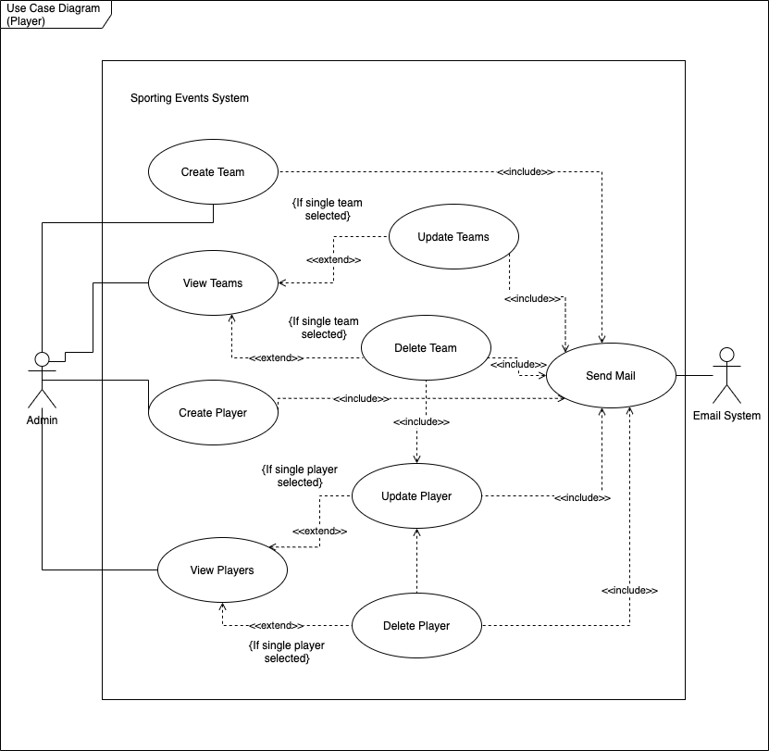
Use Case Diagram

Slide 6
Class Diagram

Slide 7
Activity Diagram

Slide 8
Sequence Diagram

Slide 9
Entity Relationship Diagram

Slide 10
Layered Architecture
UI Layer
Controller layer
service layer
Repo layer

Slide 11
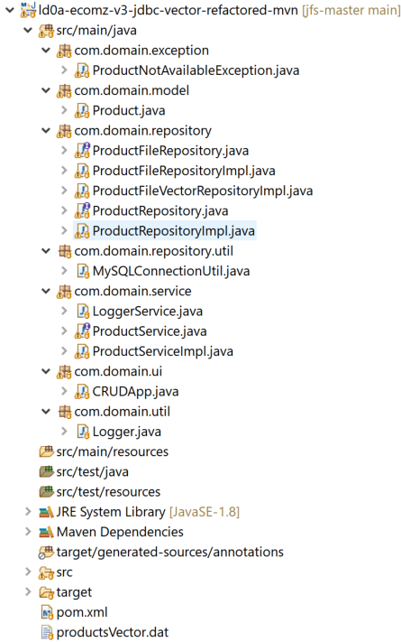
Layered Architecture implemented with Maven.
3 different repositories
FileRepository
Repository with Collections
(Repository connected to mysql later on)

Slide 12
Test-driven development (TDD)
Testing (Junit) CODE COVERAGE (Jacoco)

Slide 13
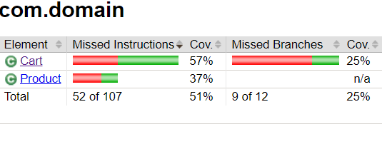
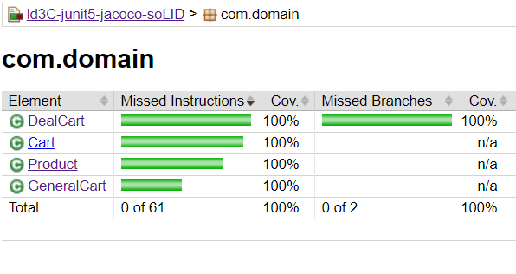
TDD with JUNIT5
Traditional Testing
TDD + SOLID Principles applied

Slide 14
Frameworks (Spring Core)
XML Config
Annotation Config
Java config

Slide 15
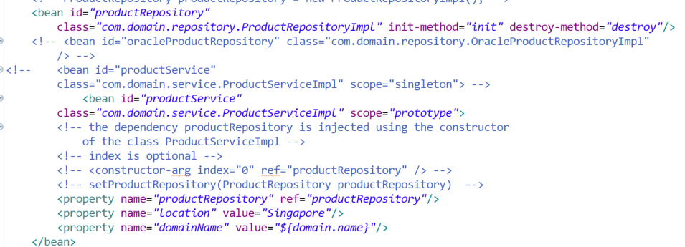
Code Snippets

Slide 16
Modular Projects of Each Team Member
JDBC Project
Spring JDBC Project
REST Project
SESProject

Slide 17
Git & GITHUB

Slide 18
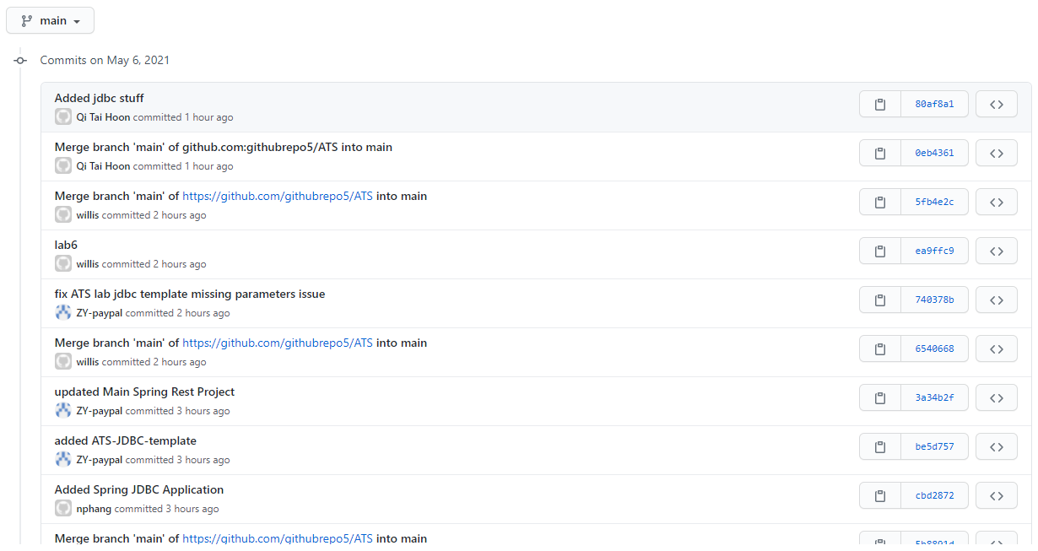
Screen shots

Slide 19
SOFTWARE CRAFTSMANSHIP
MAKING software designs THAT ARE
more understandable,
- flexible,
and maintainable.

Slide 20





SOLID Principles Applied

Slide 21
Learning & Experiences

Slide 22
Thank you!

